Slide 1
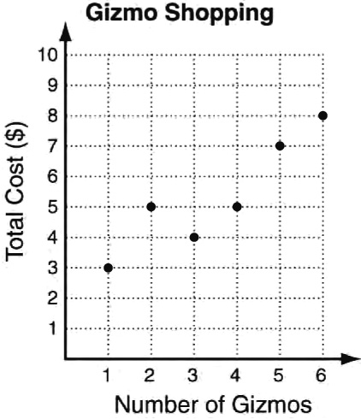
The FRAME Routine
Functions
is about… identifying functions using sets of ordered pairs, tables, mappings, and graphs.
Function
Not a Function
Ordered Pairs
{(1,3) (2,6) (3,9) (4,12)}
{(1,3) (1,6) (3,9) (3,12)}
Tables
Identify input values. Each x value should have only one y value.
input | 1 | 2 | 3
output | 3 | 6 | 9
input | 1 | 1 | 3
output | 3 | 6 | 9
Strategic Instruction Model (SIM™) University of Kansas Center for Research on Learning (KUCRL.org)
Mappings
Identify input values. Each x value should have only one y value.
1
2
3
3
6
9
1
3
3
6
9
Graphs
Use vertical line test. A vertical line should only pass through one point of a function.
X values should have only one Y value.

Slide 2
The FRAME Routine
Functions
is about… identifying functions using sets of ordered pairs, tables, mappings, and graphs.
Function
Not a Function
Ordered Pairs
{( , ) ( , ) ( , ) ( , )}
{( , ) ( , ) ( , ) ( , )}
Tables
input
output
input
output
Strategic Instruction Model (SIM™) University of Kansas Center for Research on Learning (KUCRL.org)
Mappings
Graphs
.

