Slide 1
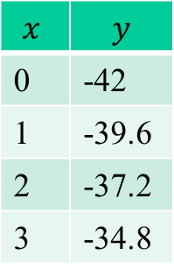
The Unit Organizer
4
BIGGER PICTURE
NAME
DATE
Problem solving
2
LAST UNIT
1
CURRENT UNIT
3
NEXT UNIT
Equations, inequalities, and applications
Unit 4 Slope and y-intercept
Proportional and non-proportional functions
8
Unit Schedule
5
UNIT MAP
is about...
Practice four corner models
Story to equation to table
Table to graph while identifying the slope from the table
Graph to table
Create similar triangles to calculate the slope
Identify proportional and non-proportional linear functions
using tables and graphs to develop the understanding of slope and y-intercept by
analyzing
Linear functions
Focus on slope…
Story | Equation | Table | Graph
Read and identify -Constant rate of change (check if it is negative) -starting point | $$y=2.4x−42$$
$$x$$ | $$y$$
0 | -42
1 | -39.6
2 | -37.2
3 | -34.8
Constant rate
slope
Starting point
Y-intercept
Where is the slope found in the story, graph, table, and equation?
Where is the y-intercept found in the story, graph, table, and equation?
How are similar triangles used to calculate slope?
Identifying
Analyzing
Interpreting
Comparing
Evaluating
Defining
Calculating
6
UNIT SELF-TEST QUESTIONS
RELATIONSHIPS
UNIT
7

Slide 2
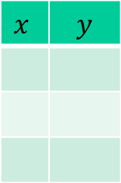
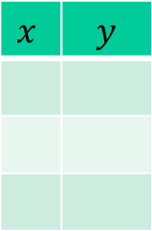
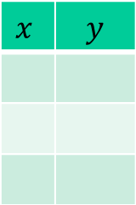
using tables and graphs to develop the understanding of slope and y-intercept by
Analyzing Linear functions
$$x$$ | $$y$$
Story
Bob has $120 and spends $9 every day on gasoline.
Slope: y-intercept:
Equation
Story
Sally has a no interest loan for $260 and repays $20 every month.
Slope: y-intercept:
Equation
$$x$$ | $$y$$
Slope
(With similar triangles)
$$x$$ | $$y$$
Story
Samantha wants to buy a new video game so she saves $12 every 3 days.
Slope- y-intercept-
Equation

